Slide 1
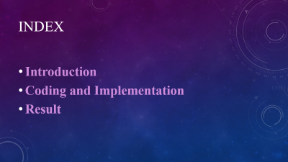
PROJECT BASED LEARNING OF DATA STRUCTURE ON SIMPLE CALENDER
BY
ABHINAV SHARMA(2100290110004)
GYANVI ASHISH CHAUDHARY(2100290110057)

Slide 2
acknowledgment
I’ve got this golden opportunity to express my kind gratitude and sincere thanks to my subject faculty “Mr. Vinay Kumar”, Computer Science and Information Technology Department, KIET GROUP OF INSTITUTIONS for their kind support and necessary counselling in the preparation of this project report. I’m also indebted to each and every person responsible for the making up of this project directly or indirectly. I must also acknowledge or deep debt of gratitude each one of my colleague who led this project come out in the way it is. It’s my hard work and untiring sincere efforts and mutual cooperation to bring out the project work. Last but not the least, I would like to thank my parents for their sound counselling and cheerful support. They have always inspired us and kept our spirit up.

Slide 3
PROJECT ABSTRACT
The calendar application presented here is a very simple console application developed using C programming language.
It is built without using graphics properties; instead it utilizes many windows properties to give the application a colorful look and feel
It is compiled in online compiler.

Slide 4
Index
Introduction
Coding and Implementation
Result

Slide 5
introduction
A calendar is a system of organizing days. This is done by giving names to periods of time, typically days, weeks, months and years. A date is the designation of a single and specific day within such a system. A calendar is also a physical record (often paper) of such a system.

Slide 6
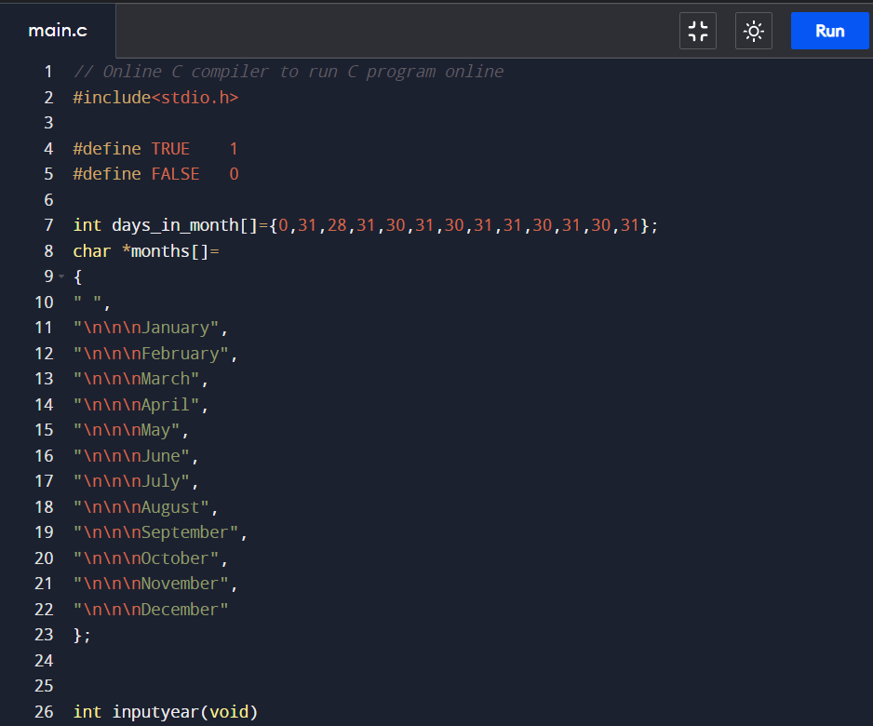
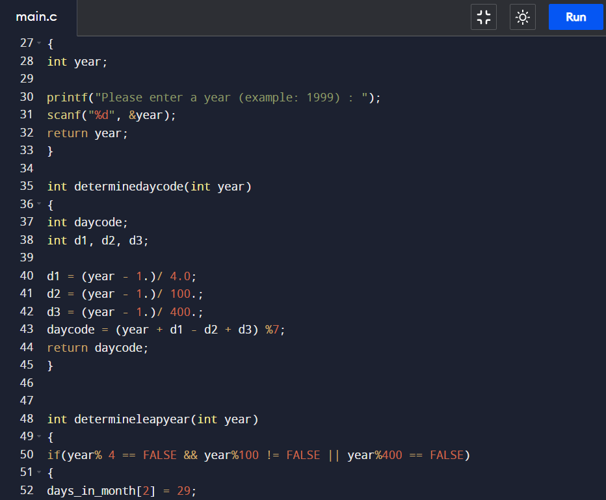
CODE IMPLEMENTATION

Slide 7
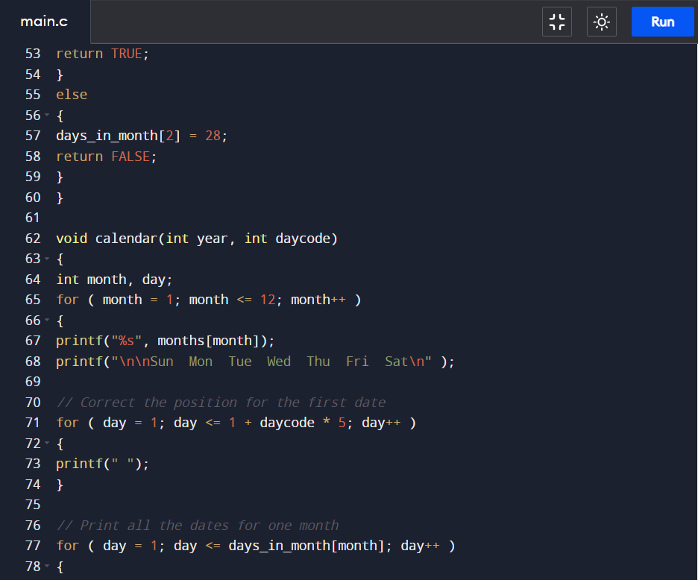
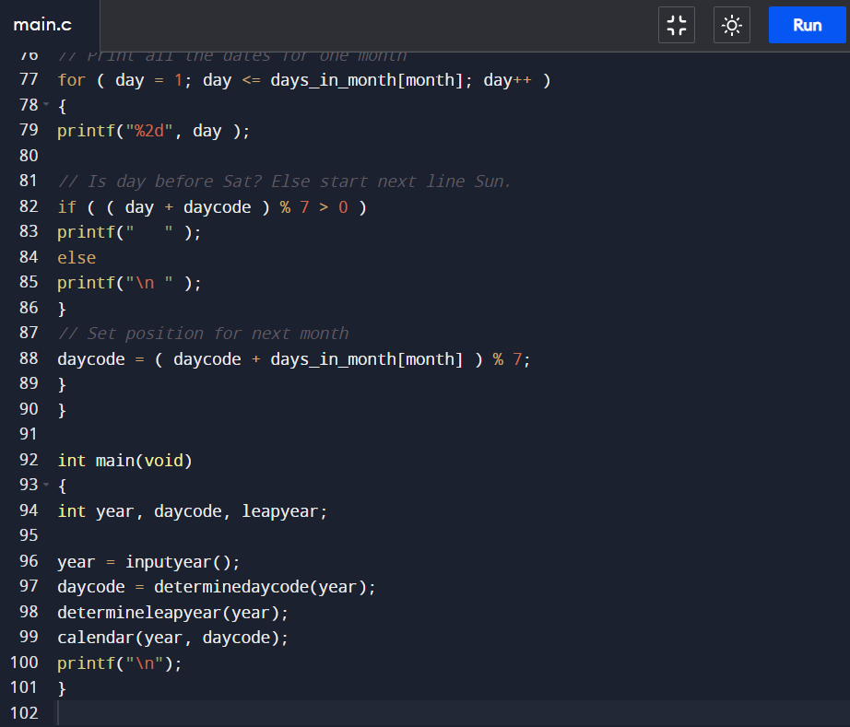
CODE IMPLEMENTATION

Slide 8
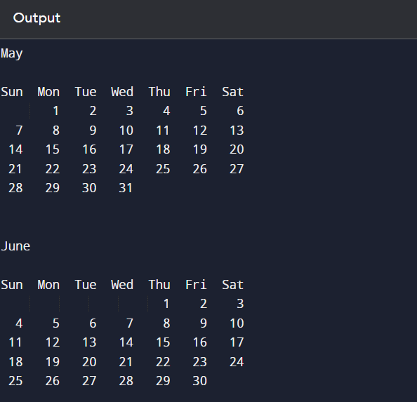
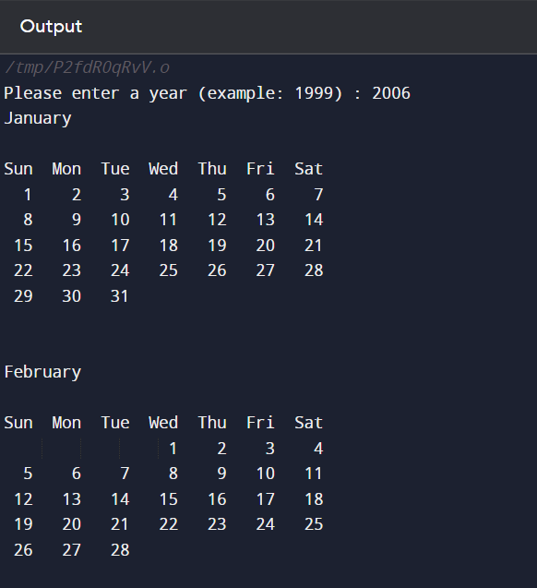
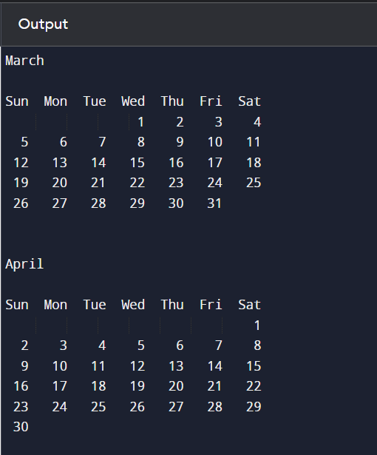
output

Slide 9
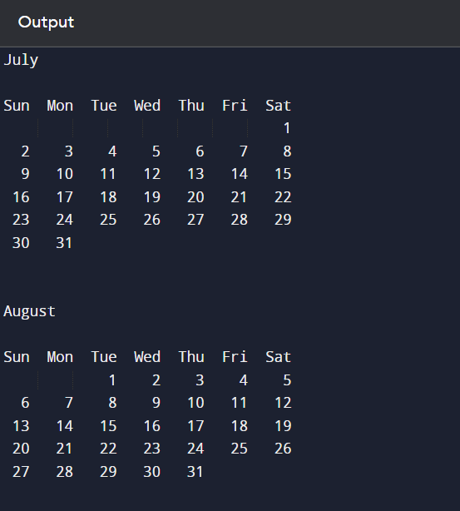
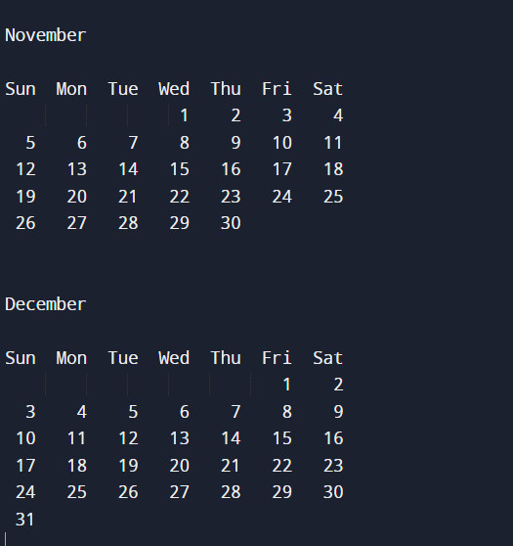
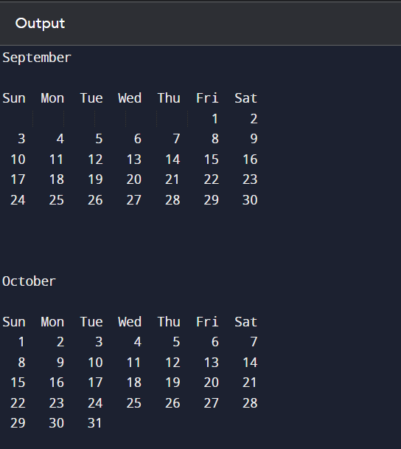
output

Slide 10
THANK YOU

